Slide 1

Azure Arc Envisioning

Slide 2
Agenda
Problem Statement
Partner Opportunity
Azure Arc Introduction
Solution Building Journey

Slide 3



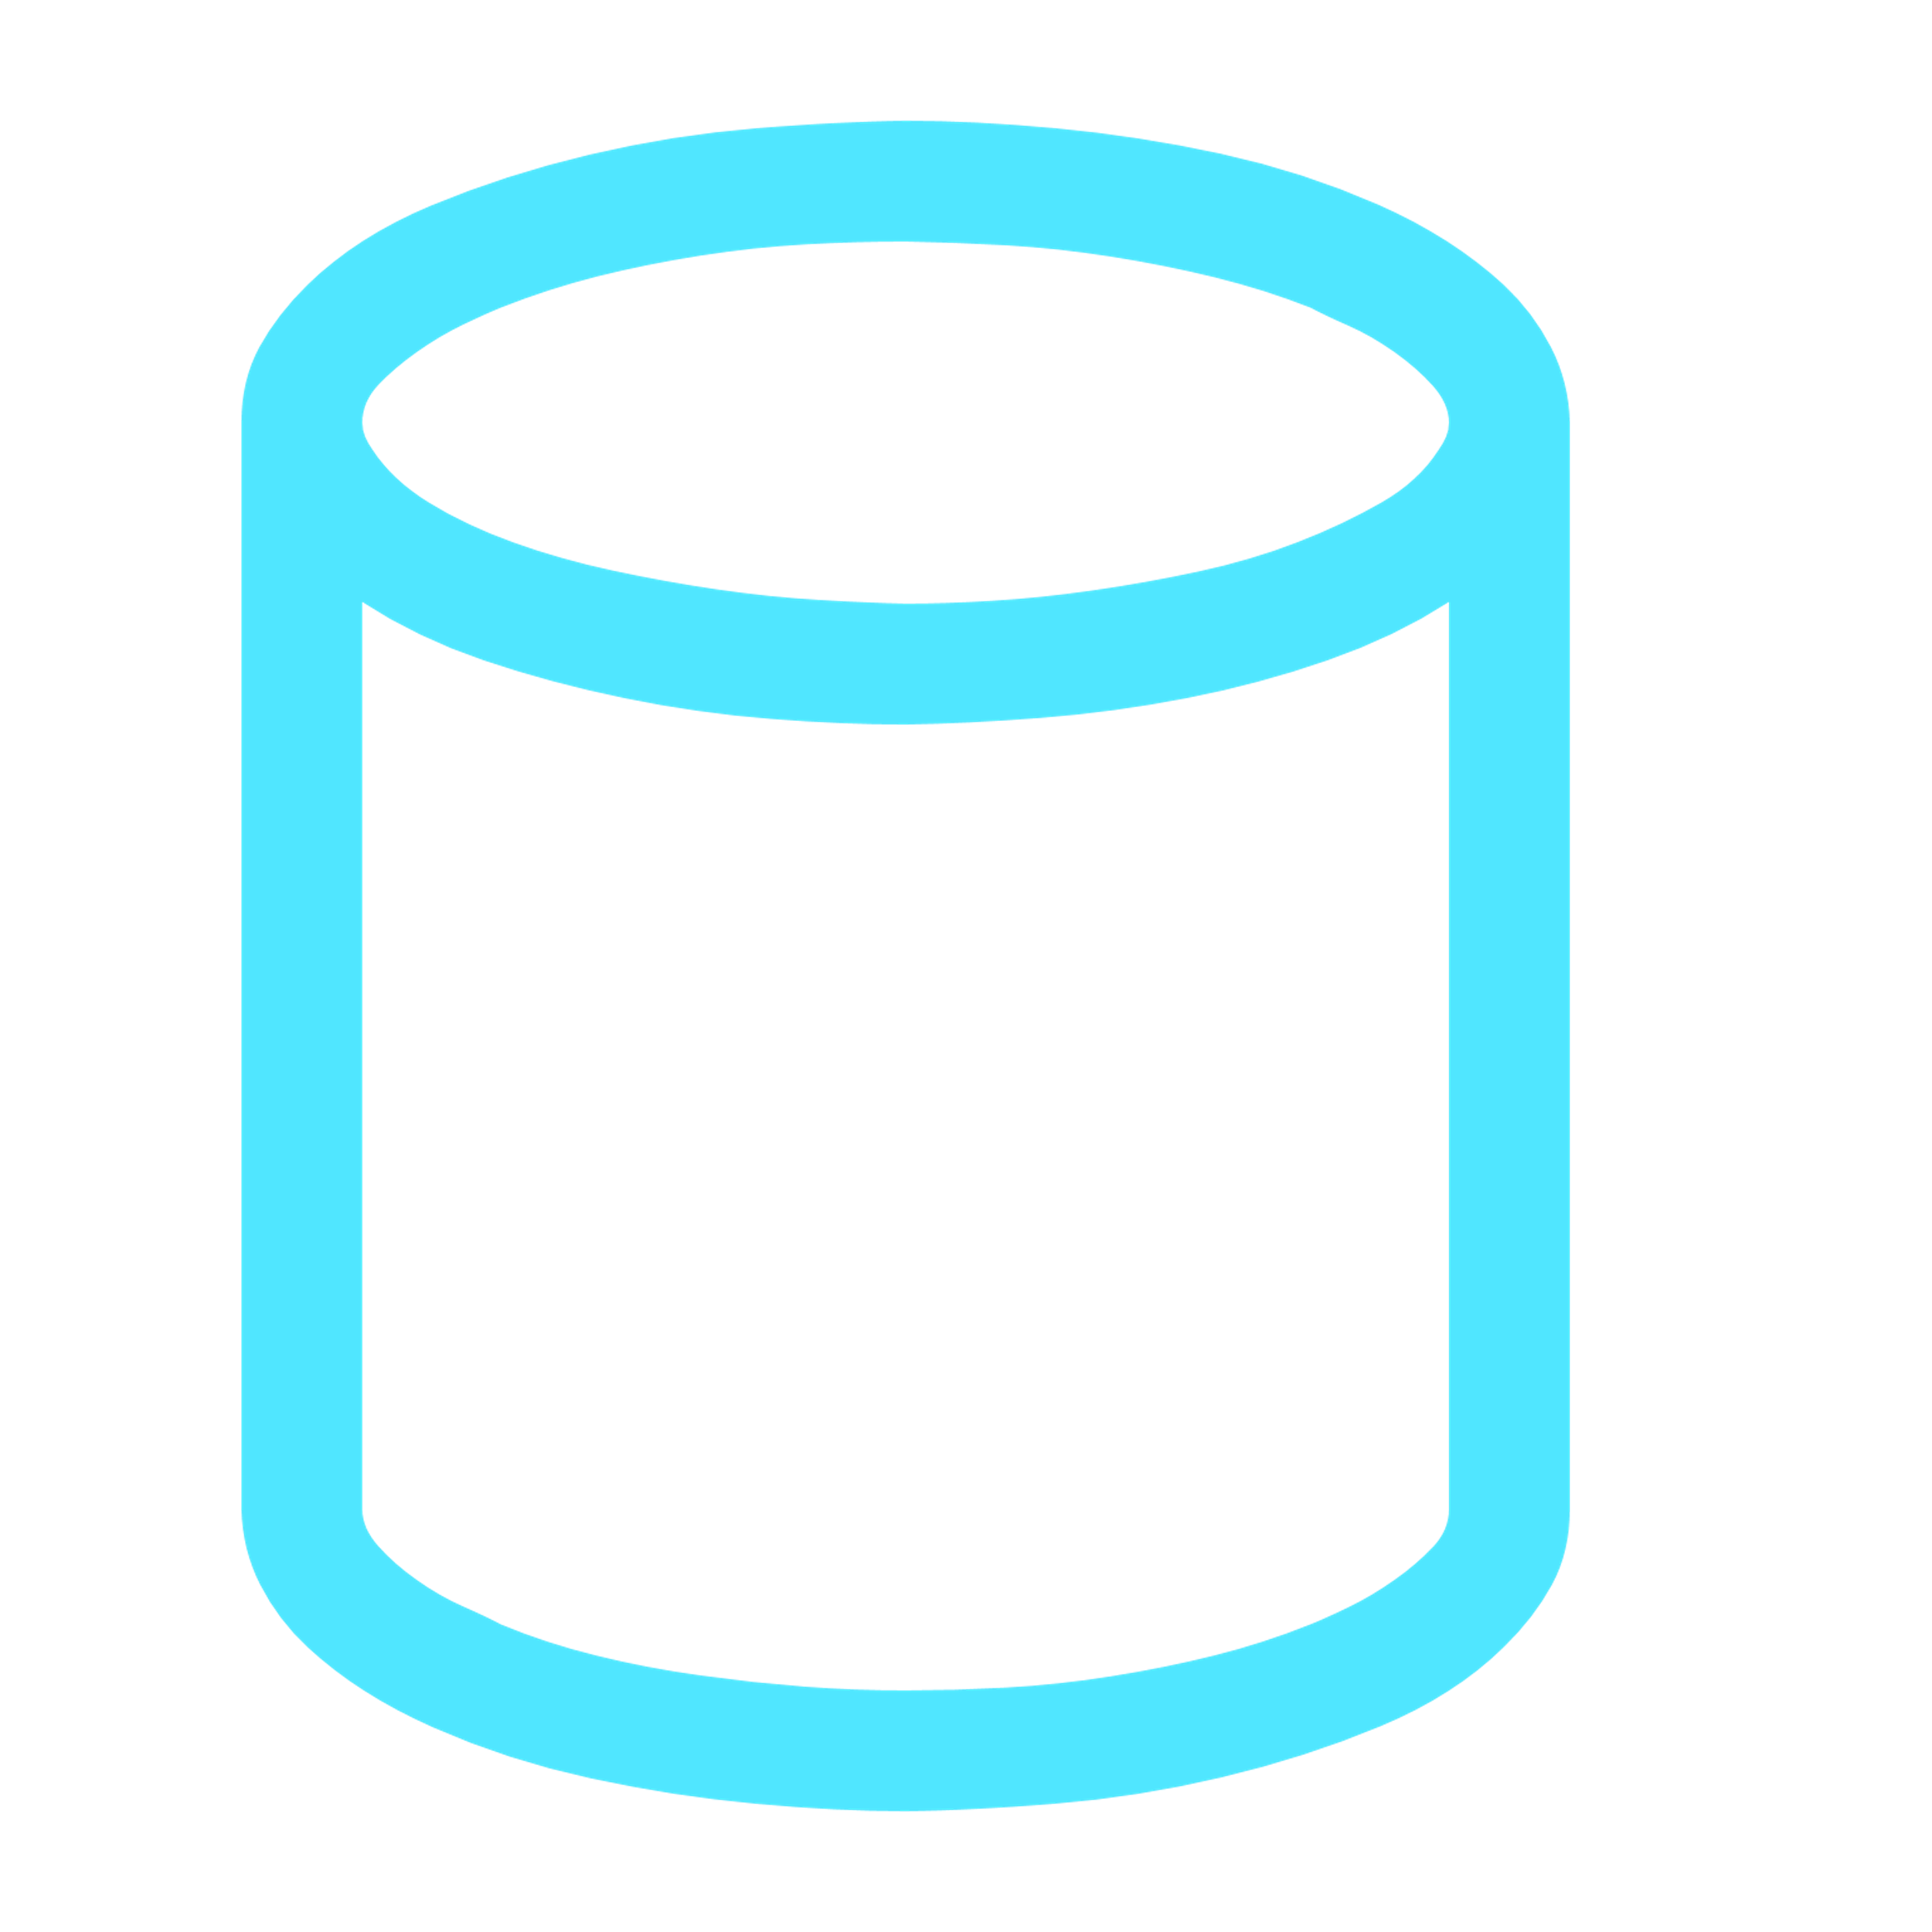
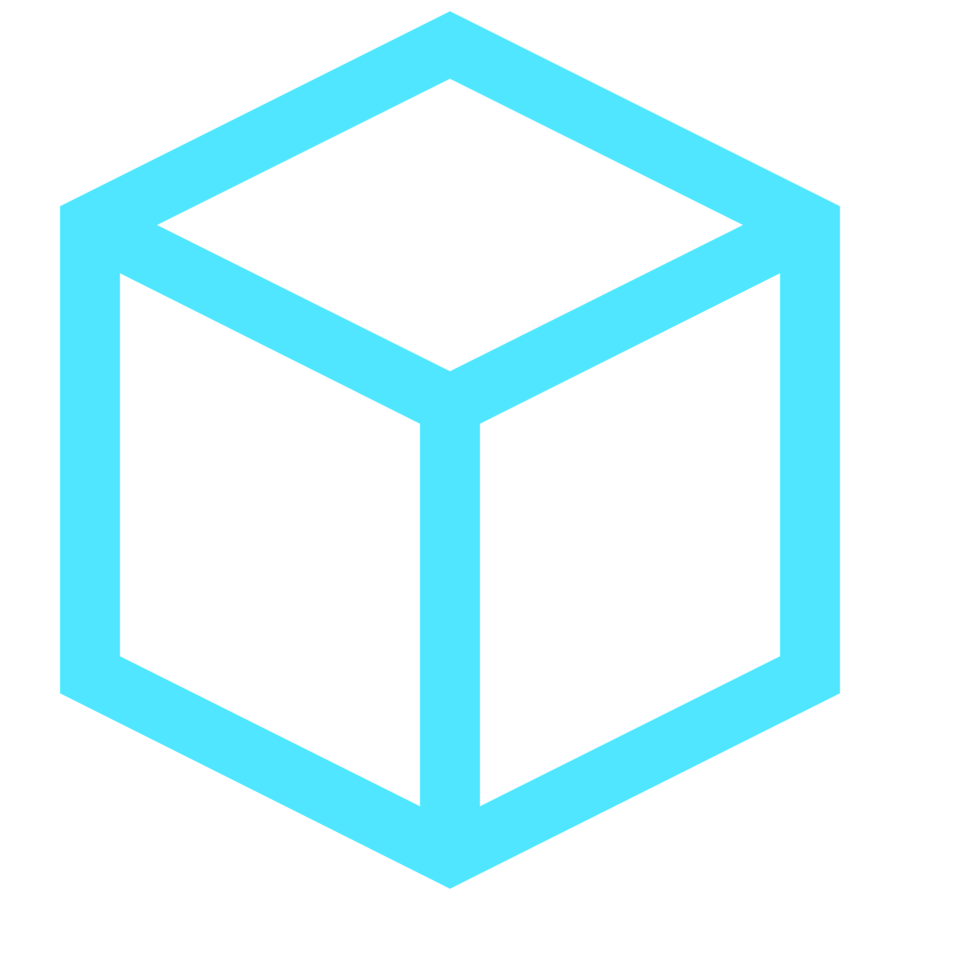


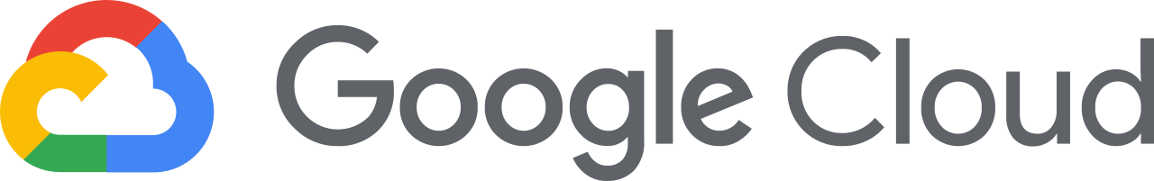




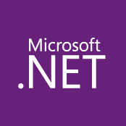




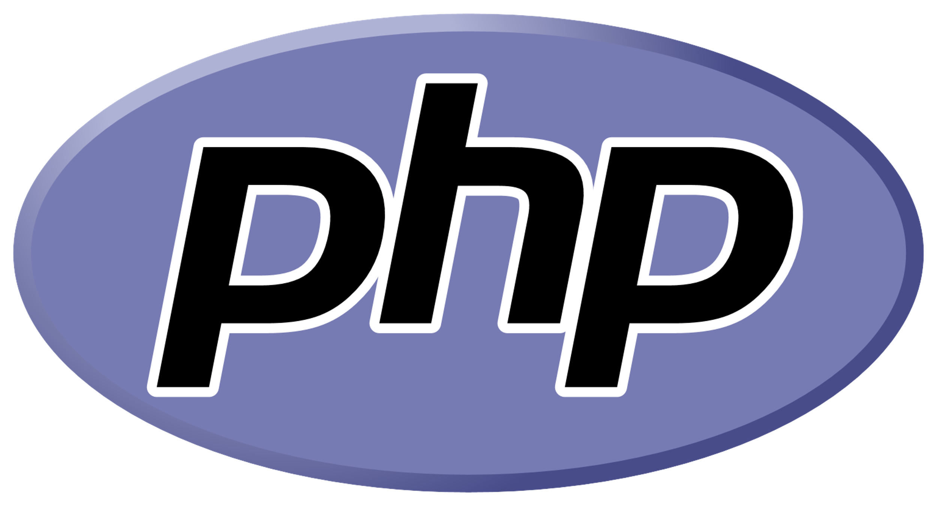


Customer environments and application requirements are evolving
Single control plane with Azure Arc
How to govern and operate across disparate environments?
How to ensure security across the entire organization?
How to best enable innovation and developer agility?
How to meet regulatory requirements and overcome technical hurdles?
100’s–1,000’s of apps
Diverse infrastructure
Hybrid & Multi-Cloud
VMs
Databases
Datacenters
Hosters
Containers
Serverless
Branch offices
OEM hardware
IoT devices
Edge
Notes:
If you look at many of our customer’s environments today, it’s clear that they continue to grow in complexity with the influx of new technologies and platform investments. I’m sure this rings true for you as well.
Applications are running across a diverse infrastructure with data centers, hosting environments, branch offices as well as multi-cloud, where we see two or more clouds being used.
To add to this complexity, your teams are using different development tools, languages, and frameworks as well as approaches like Opensource, Kubernetes and DevOps.
Key questions I often hear as we meet with customers like yourself are :
How to govern and secure resources seamlessly regardless of where they are running?
How to bring cloud innovation to existing infrastructure?
How to modernize local datacenters with new cloud infrastructure?
How to extend compute and AI to the edge to unlock new business scenarios?
At Microsoft, we have long understood this reality you’d be facing. Microsoft Azure has been designed with hybrid in mind from the beginning to help you meet these challenges.
<CLICK>

Slide 4
Durable customer reality
90%
93%
of enterprises remain hybrid
of enterprises have a multi-cloud strategy
Legacy systems / custom requirements
Regulations and data sovereignty
Latency and technical hurdles
Consequence of no proactive strategy
Key Drivers:
Source: Gartner Says a Massive Shift to Hybrid Infrastructure Services Is Underway
Source: Cloud Computing Trends: 2020 State of the Cloud Report | Flexera Blog

Slide 5
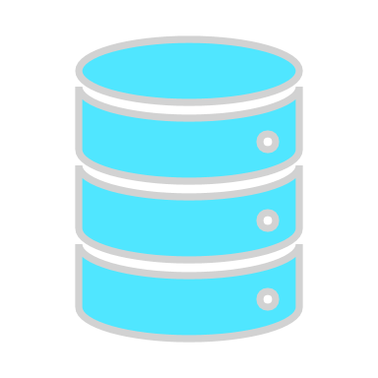
Customer understands value of the cloud but has apps and data that need to remain on-premises
Inconsistent governance and visibility across cloud and on-premises data assets
What are we hearing from partners?
Varied customer database versioning across locations and multi-cloud
“…managing customer’s environments at multiple locations is complex…”
Time-intensive management of patching, backup, HA and slow CI/CD with time consuming setup for databases
Capex and Opex for managing different sets of tools supporting complex IT environments
Traditional licensing lack flexibility to do cloud native app innovation
Notes:
Hybrid is causing pain for partners
There is no consistent view into all the assets meaning there is no consistent management, security or governance
The varied flavors of customer databases have different end of support dates that need to be managed.
They also require different tooling, different expertise, and separate manual patching, deployment, backup and HADR.
It is hard to quickly react to customer needs and slow to implement the DevOps practice of CICD as it’s time consuming to set up for the databases. (continuous integration and continuous deployment)
...

Slide 6
Extending the cloud opportunity everywhere Large TAM; millions of on-premises servers, double digit growth in containers
Cloud and infrastructure
Edge & IoT
Migration
~12m on-premises physical servers growing to ~15 million by 2024¹
~50-70m on prem virtual machines growing to 80-90m by 2024²
Cloud-native apps
Data Modernization
App Dev & Innovation
Use of containers growing from 70% to ~90%³
Large enterprises shift to containers
On-premises data
Cloud & Infra Management
Compliance & Security
Steady $28B on-premises RDBMS revenue from 2020 to 2024⁵
75% of enterprise data will be created on the edge by 2025 up from less than 20% today. ⁴
IDC Enterprise Infra Tracker; 2. Assumption: 1 physical servers = ~4 virtual machines, 3. CNCF, production and development 4. “Edge Computing Solutions for Industrial IoT” July 2018, Gartner. Microsoft (2020), 5. IDC RDBMS 5 year forecast Dec‘
Notes:
When we look at the actual numbers behind the continuum, we see there’s a varying degree of additional revenue and gross margin associated with each bucket.
Basic strategy assessment services, services spanning from infrastructure migration, app modernization, to application development, all the way to two reoccurring revenue streams of managed services and software IP sales. There’s a wide opportunity for additional revenue and more and more Azure partners have been flexing from their core business in pursuit of higher margins.
Many companies have added capabilities through standing up new practices, acquisitions, or partnering with other complementary organizations. Azure has enabled a lot of our partners to take advantage of the opportunity through our deep partner ecosystem: finding the right partners, knowledge sharing, or access to our customer base.

Slide 7

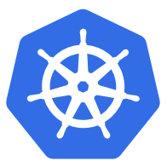

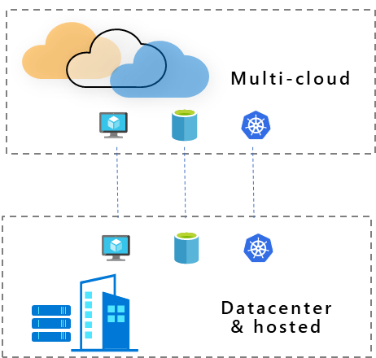
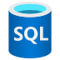
Azure Arc
Extend Azure management and services anywhere
Multi-cloud
Datacenter & hosted
Gain central visibility, operations, and compliance
Build Cloud native apps anywhere, at scale
Run Azure services anywhere
Notes:
With Azure Arc, you can benefit in 3 different scenarios. Arc helps you accelerate innovation across hybrid and multi-cloud environments with simplified management, faster app development, and consistent Azure services.
1) First, if you have workloads running outside Azure, you can centrally manage all these resources consistently in Azure, whether they are Windows, Linux, SQL Server or Kubernetes clusters. You can govern, organize, and inventory assets in a homogenous way and get central visibility to them from a single pane of glass, all from within Azure. This helps you meet governance, compliance, and organizational standards through policies for all your apps, infrastructure, and data.
2) Next, Azure Arc helps you build cloud native apps anywhere, at scale. You can leverage the modern cloud native app development practices, meaning you can use DevOps techniques to deploy and manage Kubernetes apps at scale on your choice of any certified Kubernetes distribution. You can also reduce errors with consistent configuration and policy-driven deployment and operations for applications and Kubernetes clusters. Use Arc to centrally manage and delegate access for DevOps roles and responsibilities.
3) And lastly, you can run Azure services such as Azure SQL Managed Instance and Azure PostgreSQL Hyperscale anywhere. With Azure Arc, you can implement cloud practices and automation to deploy faster, consistently, and at scale with always-up-to-date Azure Arc enabled data services.

Slide 8

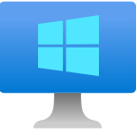



Example: Azure Arc Partner Opportunity – Migration
Scenario: A customer has 100 VMs (Linux/Windows) running on-premises. The VMs consist of file servers, SQL instances, web servers and backend servers. You as a partner have been brought in to conduct an analysis of the infrastructure, execute the migration and implement Azure Sentinel as a SIEM solution using a unified operations strategy.
Azure Policy
$ Azure Arc enabled server/month per Guest Config Policy
+ Sentinel $
50 x Azure Arc enabled Servers
Migration
50 x Azure VMs + Sentinel
50 x On-Premises VMs
50 x Azure VMs
50 x Azure Arc enabled Servers + Sentinel
100 x On-Premises VMs
PS $ generated
from the migration
+
Sentinel $
Notes:
We are starting with 100 on-premises virtual machines, generating 0$
By migrating 50 of these VMs to Azure, we are generating only for these 50 VMs but “leaving money on the table” for the other 50 on-premises VMs who “stayed behind”
We are now enabling Azure Sentinel for the 50 Azure VMs which generates more TAM but we are still not generating ANY $ for the “stayed behind” on-premises VMs
Now, by onboarding the 50 on-premises VMs into Azure Arc, which does not have a cost, we are making progress towards generating revenue for the on-premises VMs
By applying Azure Policy, which will enforce Azure Sentinel on all 50 on-premises Azure Arc enabled servers, we are now generating (example) 6$ per Azure Arc enabled server via Azure policy as well as $ coming from Azure Sentinel/Security services. This means we are maximizing the TAM opportunity and no longer leaving money on the table!
This example shows the potential of “unlocking” an Azure service such as Sentinel for on-premises assets which without Azure Arc, would have not generate any $,
Like Azure Sentinel, other Azure services can be unlocked using Azure Arc. Services such as (but not limited to) Azure Security Center, Azure Monitor, Azure Log Analytics, etc. can now all be applied and utilized by Azure Arc enabled servers.

Slide 9




Example: Azure Arc Partner Opportunity – Migration
Scenario: A customer has 100 VMs (Linux/Windows) running on-premises. The VMs consist of file servers, SQL instances, web servers and backend servers. You as a partner have been brought in to conduct an analysis of the infrastructure, execute the migration and implement Azure Sentinel as a SIEM solution using a unified operations strategy.
Azure Policy
$ Azure Arc enabled server/month per Guest Config Policy
+ Sentinel $
50 x Azure Arc enabled Servers + Azure Services
Migration
50 x Azure VMs + Sentinel
PS $ generated
From the migration
+
Sentinel $
Notes:
This example shows the potential of “unlocking” an Azure service such as Sentinel for on-premises assets which without Azure Arc, would have not generate any partner revenue,
Like Azure Sentinel, other Azure services can be unlocked using Azure Arc. Services such as (but not limited to) Azure Security Center, Azure Monitor, Azure Log Analytics, etc. can now all be applied and utilized by Azure Arc enabled servers.

Slide 10




Azure Lighthouse
Your Practices
Multi-cloud
Datacenter
Edge
Azure Lighthouse
Azure Management
Azure Arc
Customer 1
Customer 1
Customer 2
Customer 2
Customer 3
Customer 3
Notes:
So far we learnt about Azure Lighthouse and Azure Arc. Let’s see how this can work for a service providers/partners.
As a service provider, with Lighthouse you have a precise, granular access to customers Azure environment. A customer can delegate a specific subscription or resource group to Service provider, who can manage multiples customers from their own environment.
We hired 3rd party company - Forrester to quantify the impact of Lighthouse on partners. Per Forrester, Azure Lighthouse can help a medium size partner save ~$2-3M/year in opex.
In addition, our own analysis tells us that the Azure environment that is managed by a partner through Lighthouse, grows in revenue incrementally by ~10-20% faster than normal growth.
Click.

Slide 11
Azure Lighthouse and Azure Arc Azure Arc extends Azure management, services, and Azure Lighthouse anywhere
Your Practices
Multi-cloud
Datacenter
Edge
Azure Lighthouse
Azure Management
Azure Arc
Customer 1
Customer 1
Customer 2
Customer 2
Customer 3
Customer 3
Windows Server | Linux | Kubernetes | SQL | Azure data services
Notes:
Now, through Arc, similar capabilities and benefits can also be applied to customers' environments that are everywhere. These hybrid management capabilities can provide partners generate even additional operational savings and growth opportunities.

Slide 12
Enhance practices with Azure Arc
Use Azure Arc to get full visibility for assessment and attach Azure services to move from a one-time to continuous engagement.
Migration
Cloud and infrastructure management
Develop consistent and transferable skills across environments and reduce custom development through Azure services
Leverage continuous Azure investment in K8s and developer tools. Simplify hard to find talent acquisition with a platform built for diverse skillsets.
App modernization and innovation
Data modernization and sovereignty
Expand your data practices to Azure managed PaaS data services running in datacenter, edge or even other clouds
Governance, compliance, and security
Offer consistent at-scale Azure governance and security fully integrated with the management and identity services

Slide 13
Azure Arc enabled practices
Simplify hybrid for every practice in your portfolio
Expand revenue opportunities
Improve operational efficiency
Overcome common objections
Expand to subscription-based pricing models
Consistent Security and governance across customer environment
Offer mature at-scale cloud services
Extend existing cloud solutions to on-premise & multi-cloud
Comprehensive Kubernetes, servers, & data services management on any cloud or infrastructure
Accelerate cloud migration & infrastructure modernization
Standardize DC operations with unified management & consistent tooling
Automate everything through a single control plane
Governance & security with role-based access
Shift from CAPEX to OPEX cost basis
Provide scale hybrid cloud native app development & deployment
Lighthouse for cross tenant management
Benefit from existing Microsoft/customer relationship
Resolve on-prem and regulatory requirements
Address latency & legacy considerations
Ensure security & compliance across environments
Notes:
With Azure Arc, you can benefit in 3 different scenarios. Arc helps you accelerate innovation across hybrid and multi-cloud environments with simplified management, faster app development, and consistent Azure services.
1) First, if you have workloads running outside Azure, you can centrally manage all these resources consistently in Azure, whether they are Windows, Linux, SQL Server or Kubernetes clusters. You can govern, organize, and inventory assets in a homogenous way and get central visibility to them from a single pane of glass, all from within Azure. This helps you meet governance, compliance, and organizational standards through policies for all your apps, infrastructure, and data.
2) Next, Azure Arc helps you build cloud native apps anywhere, at scale. You can leverage the modern cloud native app development practices, meaning you can use DevOps techniques to deploy and manage Kubernetes apps at scale on your choice of any certified Kubernetes distribution. You can also reduce errors with consistent configuration and policy-driven deployment and operations for applications and Kubernetes clusters. Use Arc to centrally manage and delegate access for DevOps roles and responsibilities.
3) And lastly, you can run Azure services such as Azure SQL Managed Instance and Azure PostgreSQL Hyperscale anywhere. With Azure Arc, you can implement cloud practices and automation to deploy faster, consistently, and at scale with always-up-to-date Azure Arc enabled data services.

Slide 14




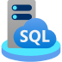
Enhance offerings with Azure Arc
Run Azure services anywhere
4
Integrate into automations & dashboards
3
Governance & security at scale
2
Global inventory, tagging, automation, & search
1
Existing tools
Customer resources
Notes:
Single agent install for over XXX number of Azure management and security services
Apply Azure governance and security, at scale, with no custom development
Automate ARM calls into your existing automations and dashboards

Slide 15










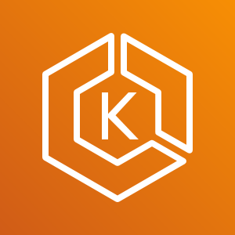

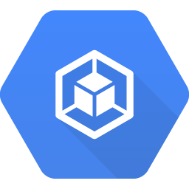

Contoso MSP Tenant Powered by Azure Lighthouse
Access Management
Portal & Dashboarding
Policy & Governance
Monitoring
Logging & Analytics
Cost Management
Security
Patch Management
BC/DR
MSP 3rd Party
Solutions Integration
Service Health
& Support
Fabrikam Azure Tenant
Parnell Aerospace Azure Tenant
App Services
Fourth Coffee Azure Tenant
Virtual Machines
Storage
Network
Kubernetes
Service
Data
Services
Cosmos DB
Functions
Parnell Aerospace
On-Premises Datacenter
Parnell Aerospace
Multi-Cloud Workloads
Azure Arc enabled infrastructure & services
Fourth Coffee
On-Premises Datacenter
Fourth Coffee
Multi-Cloud Workloads
Azure Arc
Azure Arc
SQL Server
Azure Arc
SQL Managed
Instance
Azure Arc
PostgreSQL
Hyperscale
Azure Arc
SQL Server
Azure Arc
SQL Managed
Instance
Azure Arc
PostgreSQL
Hyperscale
Bare-Metal
Servers
Windows & Linux
Servers
Kubernetes
Bare-Metal / VM
AWS
EC2
Elastic
Kubernetes
Service (EKS)
GCP
Instance
Google
Kubernetes
Engine (GKE)
Azure Arc Data Controller
Azure Arc Data Controller
Fabrikam On-Premises Datacenter
Fabrikam Multi-Cloud Workloads
Notes:
To wrap it all-up, I think this one slide summarizes everything we’ve talked about. This also show the integration with Azure Lighthouse in a multi-tenant, multi-cloud management scenario.

Slide 16


Azure is already trusted and proven by our customers. Azure Arc uses the same APIs and the same control plane as Azure, providing consistency across the hybrid infrastructure, which increases productivity and reduces risk.”
Mike DeLuca
Global Lead for Hybrid
Avanade
Notes:
Avanade, a Microsoft Platinum partner, is using Microsoft Azure Arc to unify its customers’ hybrid infrastructures.
Situation : IT infrastructures often span on-premises, cloud, hybrid, and edge computing. This complicates IT management, app development, and governance. Systems integrator Avanade wanted to help simplify workload migration decisions and infrastructure management for its customers
Solution : Avanade, a Microsoft Partner, uses Microsoft Azure Arc to extend Azure management and services across all types of infrastructure. The data Azure Arc surfaces includes not just technical and descriptive details, but also compliance and governance policies.
Impact : With Azure Arc, Avanade helps customers make more-informed decisions about cloud migration, and they can now manage their entire infrastructure through a universal control plane. With Azure Lighthouse, Avanade can better manage customer resources and continue building strong customer relationships
Read more here : https://customers.microsoft.com/en-us/story/836305-avanade-partner-professional-services-azure-arc

Slide 17


With Azure Arc we are able to distribute solutions and workloads across multiple clouds and data centers to support our clients that would have otherwise been bound to a data center.”
Aram Lauxtermann
Director, Cloud
KPMG

Slide 18
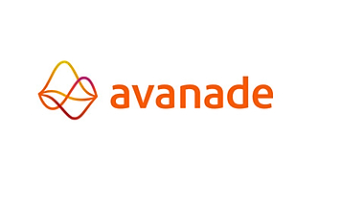
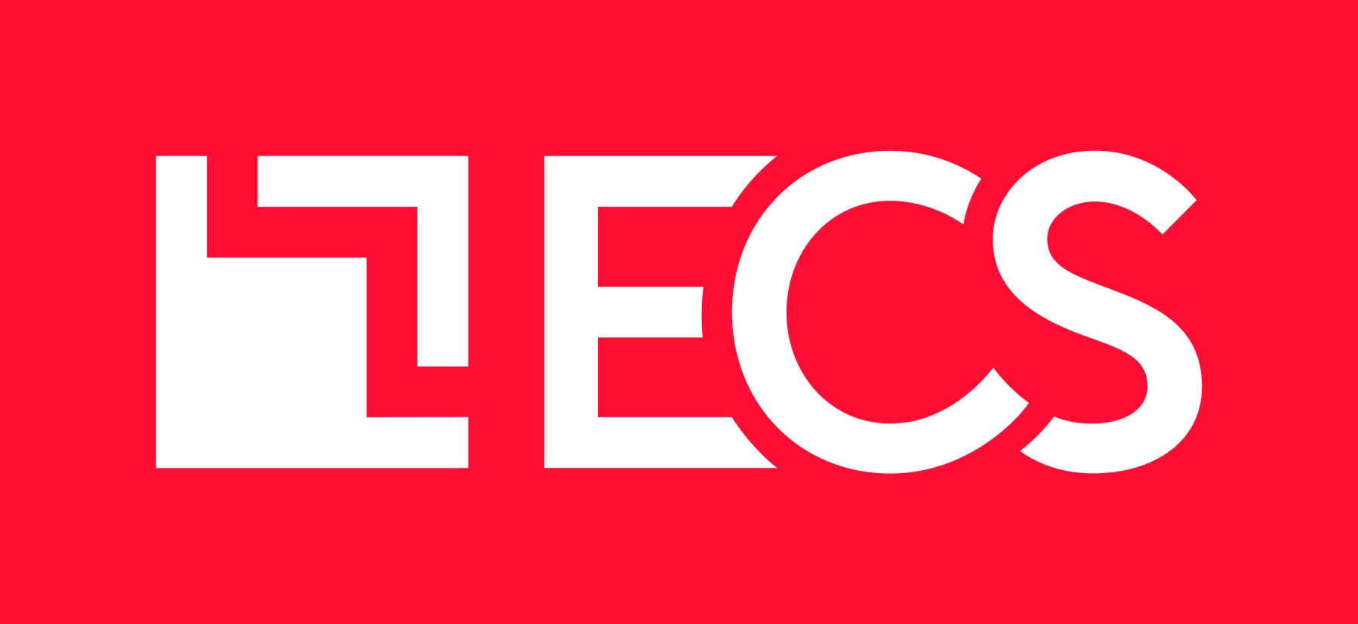

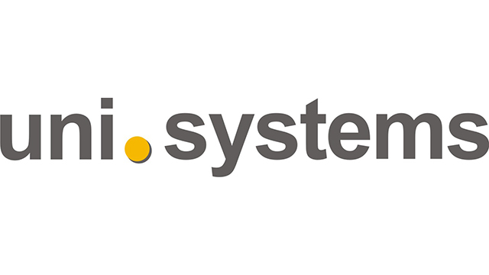
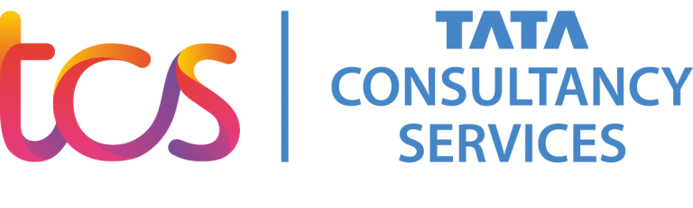
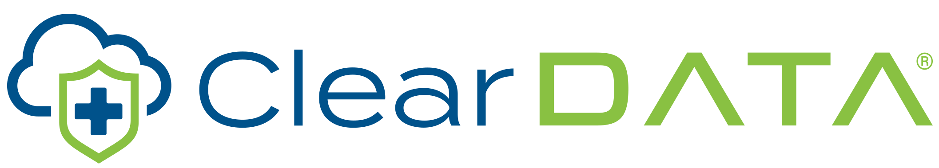
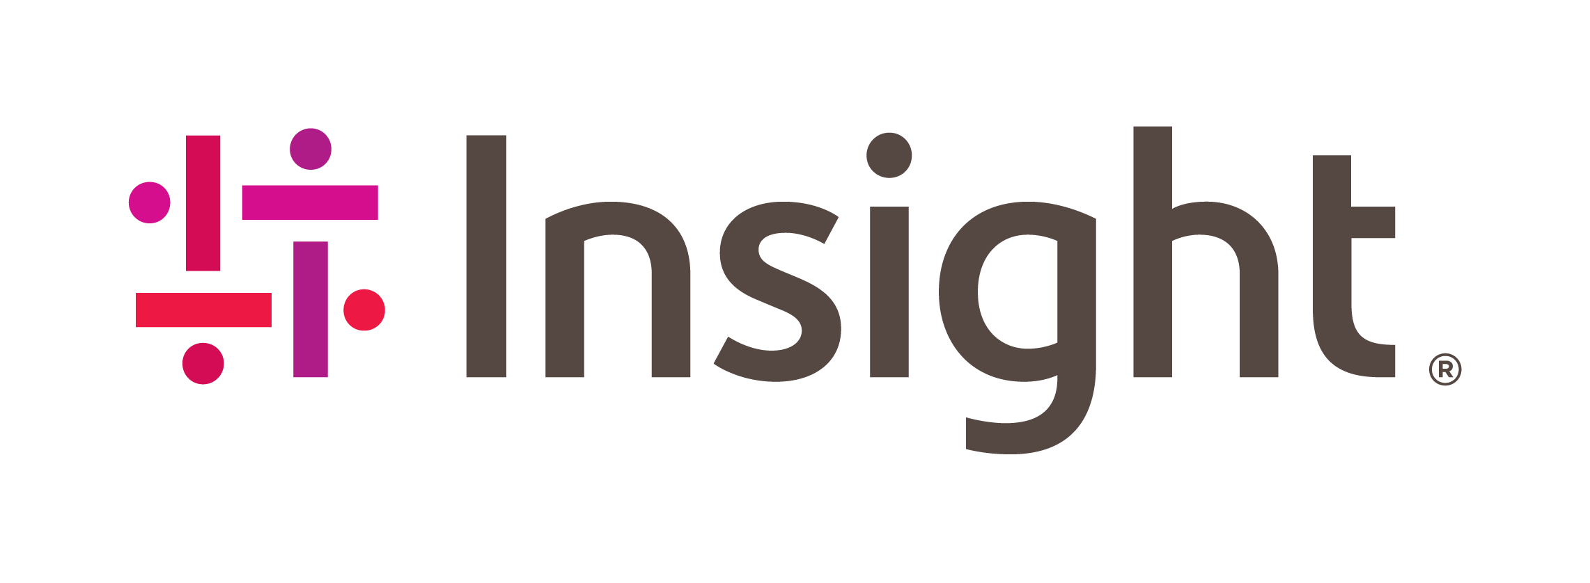


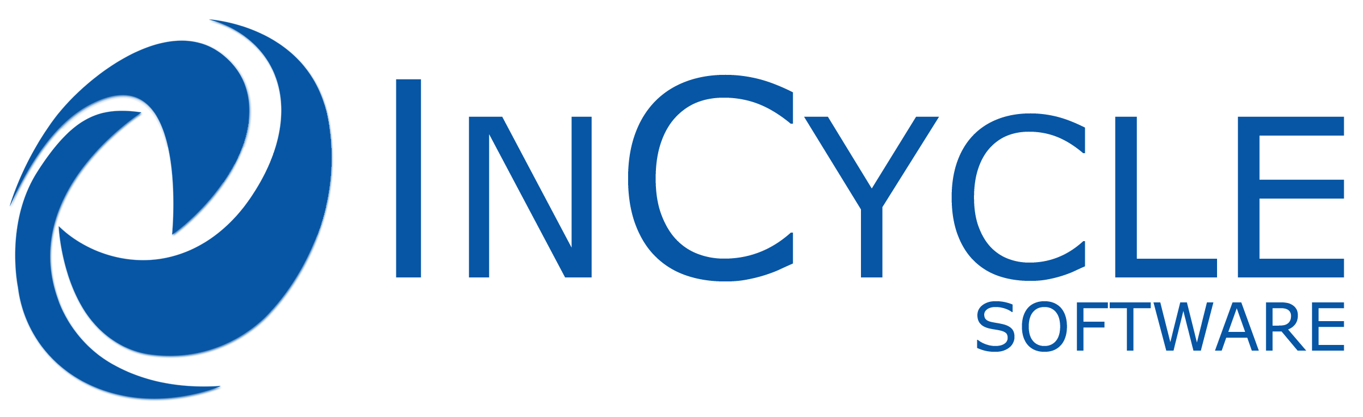


Join other Azure Arc Partners
Notes:
As you can see Azure Arc has a lot of capabilities that help you unify operations and modernize your data center through cloud native services. We have a wide ecosystem of partners that are experts on Azure Arc and can help you get going, and together with Azure Lighthouse Azure Arc becomes a really powerful tool when you are working with one of our partners.

Slide 19
Azure Arc Partner Solution Journey
Line-up Microsoft
Internal Sync on Azure Arc Solution goals and Microsoft Commitment
Line-up Partner
Partner sync to discuss program milestones, timelines, and resource commitment
Technical Workstream
assessment, training and technical BoM build-out
Business Workstream
Publish offering, OCP GTM plan, solution BoM and program alignment
Program Launch
Presales training, customer opportunities support from Microsoft CSA and product group
Grow & Ongoing Development
Business & Technical tracking, solution optimization, case studies, wins and pipeline development

Slide 20

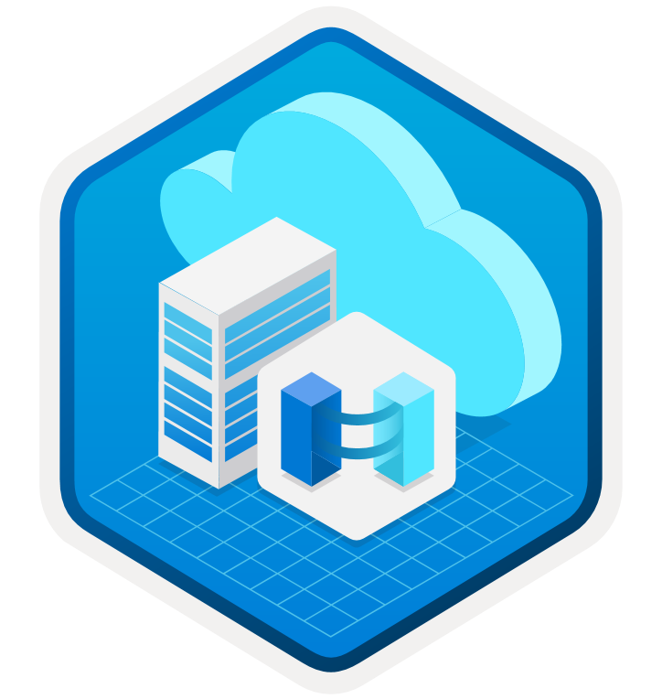
Start Today and Learn More
Azure Arc scenario-based automations & docs
Microsoft Learn Azure Arc
learning modules
Azure Arc
Tech Community
Complete guidance for hybrid and multi-cloud approach
with Microsoft Cloud Adoption Framework for Azure
Notes:
Azure Arc Jumpstart
Azure Arc "What the Hack" (WTH)
Co-Sell Resources

